Slide 1
Listening to your joints – Engineering technology to help heal joint disease
Daniel Whittingslow, MD/PhD Student
1

Slide 2

Who Am I?
Daniel Whittingslow (www.dcwhittingslow.com)
5th year MD/PhD Student
Graduate of GT BME (2013), minors in research, material science engineering, and Spanish
Research experience with heart valves, biomaterials, orthopedic implants, and now wearable health monitoring devices
Work in Dr. Inan’s Non-Invasive Physiological Monitoring Lab (www.irl.gatech.edu).
Study joint acoustical emissions using signal processing, custom hardware, a cadaver model, and patients
2

Slide 3



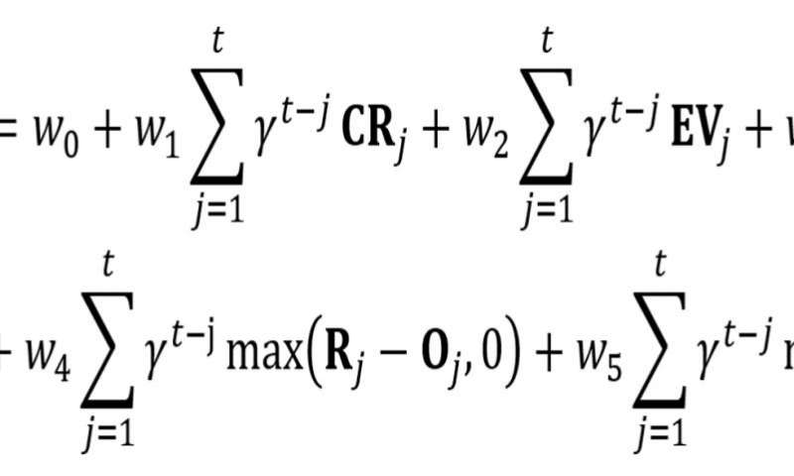
What’s my job?
ME
How do I do it?
3

Slide 4

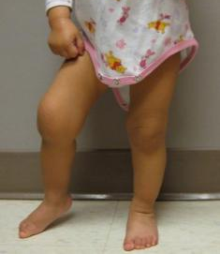
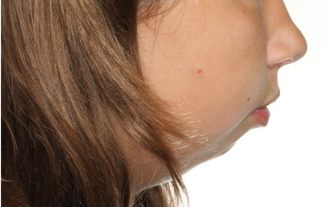


1. Identify a problem:
Juvenile Idiopathic arthritis
300,000 children in U.S. have JIA.
JIA presentation varies making diagnosis difficult and often subjective.
The knee and TMJ are commonly affected.
Early diagnosis and treatment are key to prevent growth and functional abnormalities.
Closest pediatric rheumatologist to the patient can be more than 200 miles away.
We need a method for easily monitoring JIA that doesn’t require as many clinical visits.
4
Reference: Petersson, A. (2010), What you can and cannot see in TMJ imaging – an overview related to the RDC/TMD diagnostic system. Journal of Oral Rehabilitation

Slide 5
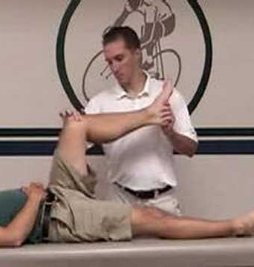
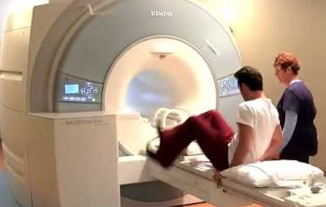
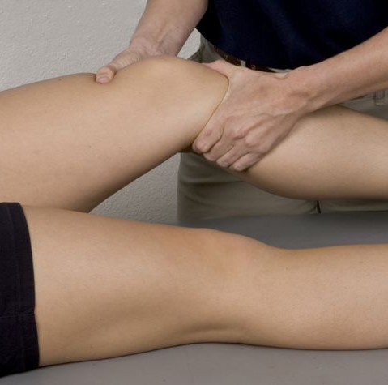
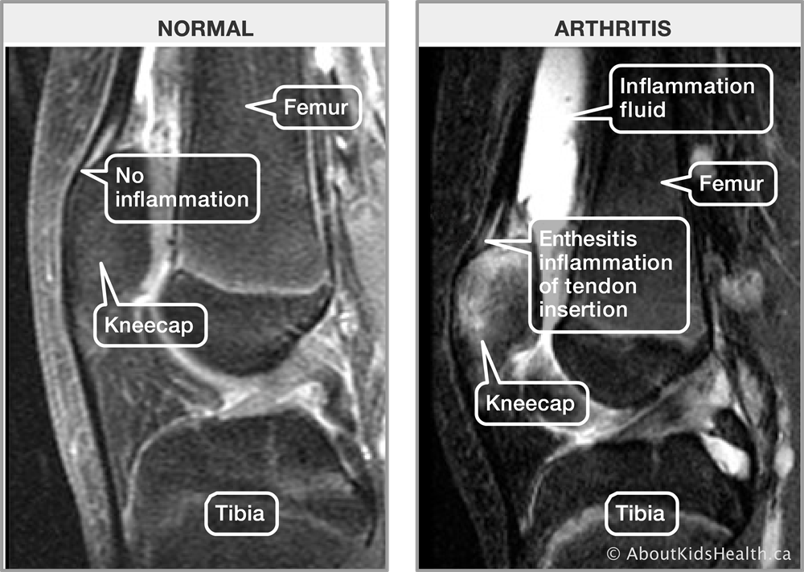
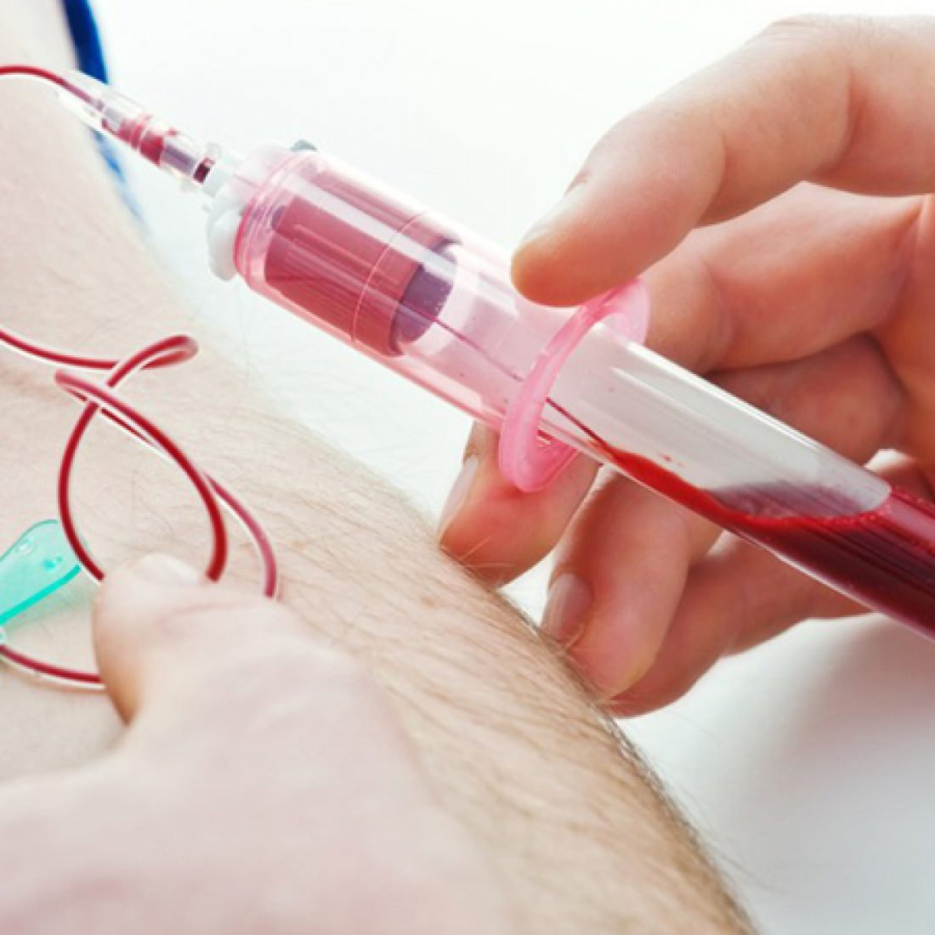

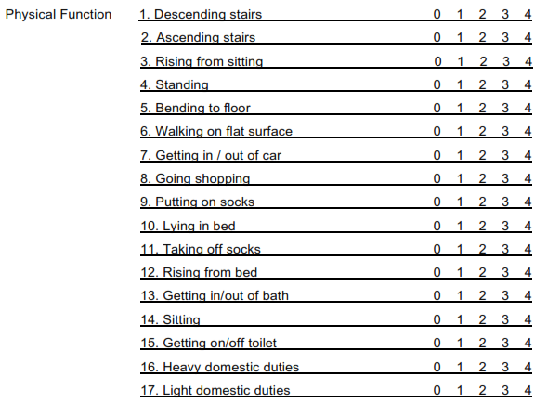
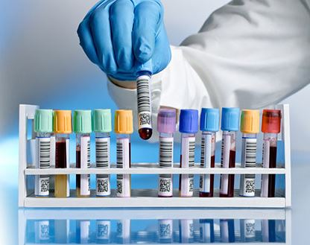
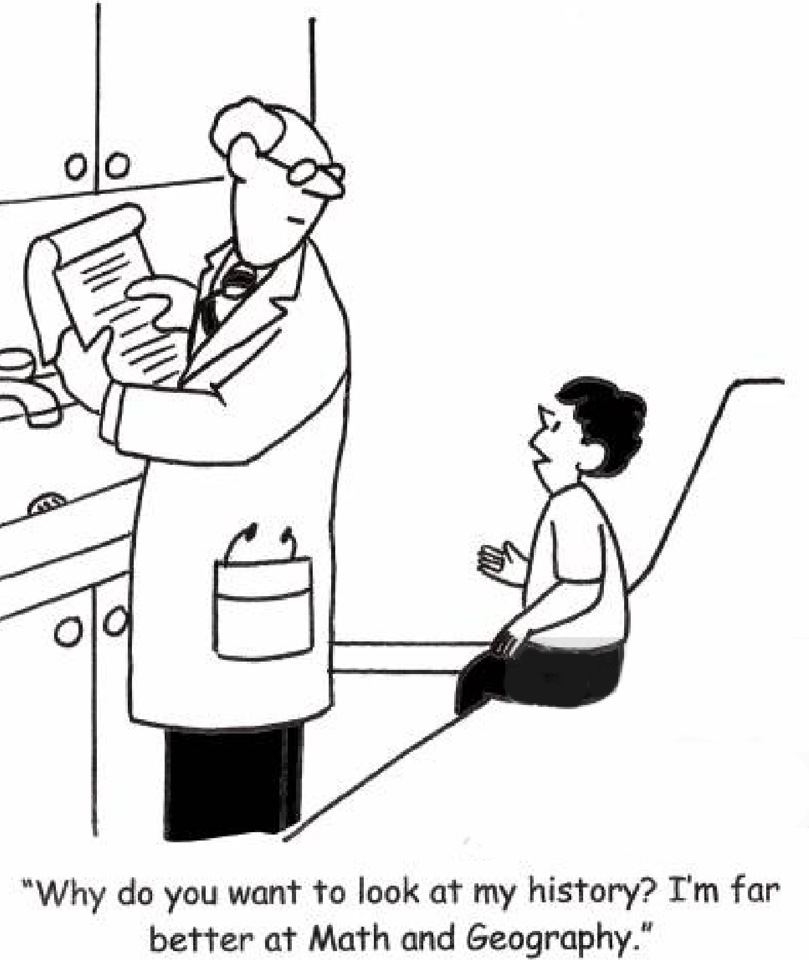
2. Understand the problem
Current Standard of Care
Physical Exam
Imaging
3. Identify an Opportunity
A quantitative biomarker of joint health, measured with affordable hardware, could improve this care by allowing for better longitudinal assessment outside of clinic.
Lab Tests
Patient Reported Symptoms
Questionnaires
5

Slide 6
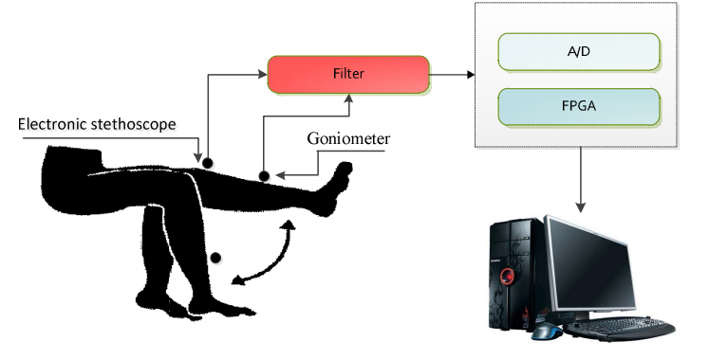
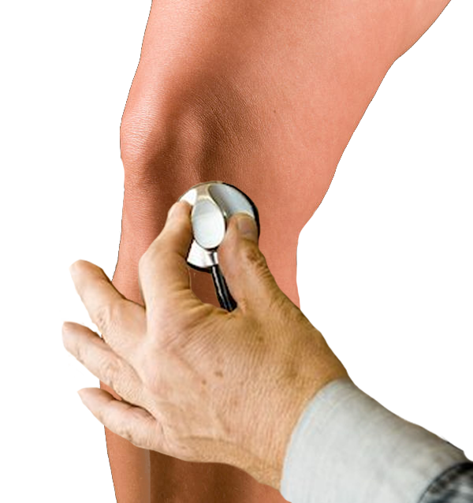
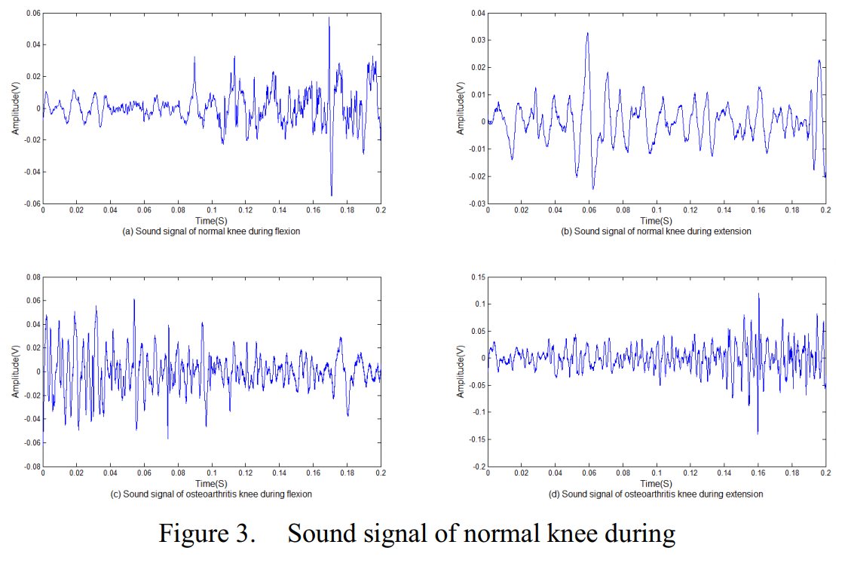
4. Do your background research
Could Joint sounds aid in msk diagnosis?
You have to be willing to take a risk and try something new!
“The following observations are recognized to be insufficient. They are therefore hesitatingly offered. It is hoped, that this preliminary report may stimulate independent investigation.”
“Auscultation can be applied to any of the large joints, but thus far I have listened almost only to the knee, as it is most accessible and most liable to disease and difficulty of diagnosis.”
Fig 3. Blodgett first proposed auscultating the knee in 1902.
Fig 4. Vibroarthography signal from normal and OA knees. Recorded in lab setting using digital stethoscope. (87.7% sensitive, 82.7% specific)
7
Ref: (Left) W. E. Blodgett, “Auscultation of the knee joint,” Boston Med. Surg. J., 1902 (Right) Lee, T. F. et al., “Analysis of vibroarthrographic signals for knee osteoarthritis diagnosis,” Conf. Genetic Evol., 2012

Slide 7
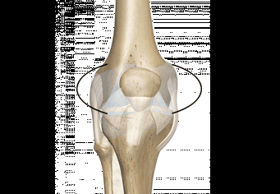
6. make a hypothesis
Acoustic emissions (AEs) generated during joint articulation contain clinically-relevant information pertaining to the underlying health of joints.
Joint sounds
8

Slide 8
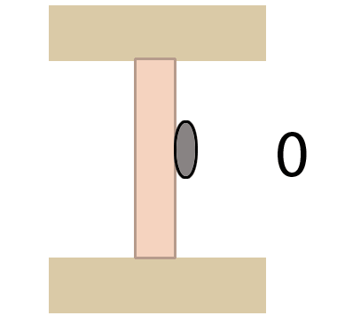
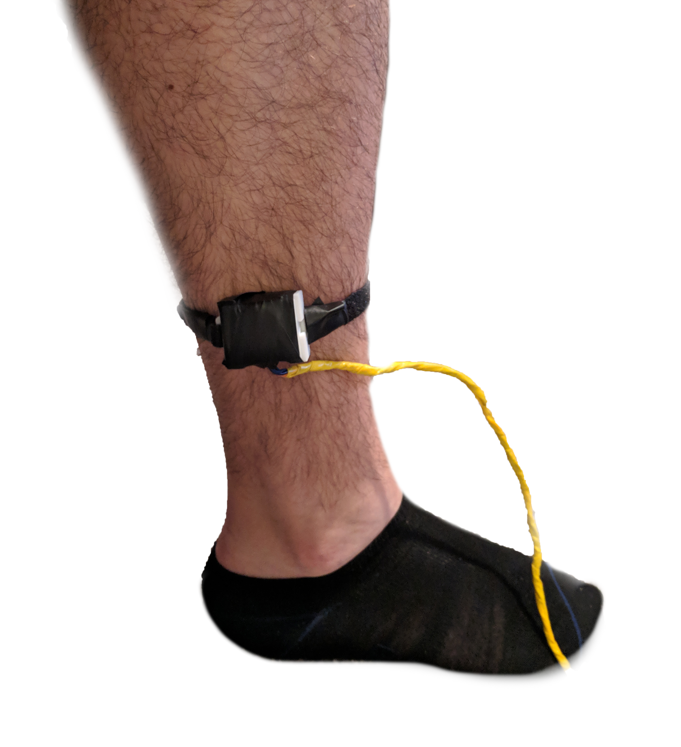
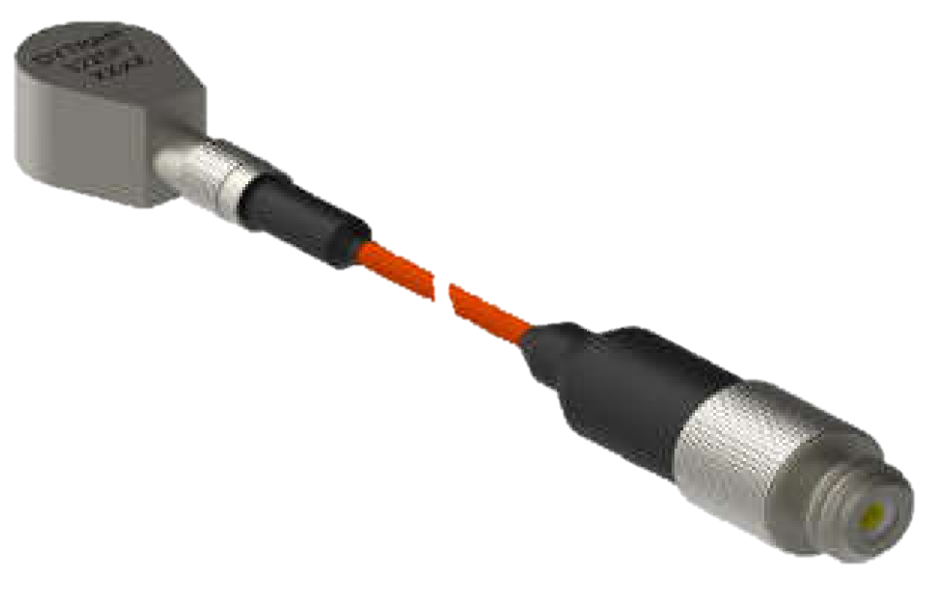
7. Design a system for testing your hypothesis.
Joint Sound capture:
  Research and use any tools that will get the job done
  Leverage commercially available tech
  Look across fields to find inspiration
  My system uses contact microphones and Inertial Measurement Units (IMUs).
3cm
Contact Microphone
Mechanism of vibration recording
IMU-based motion tracking
9

Slide 9
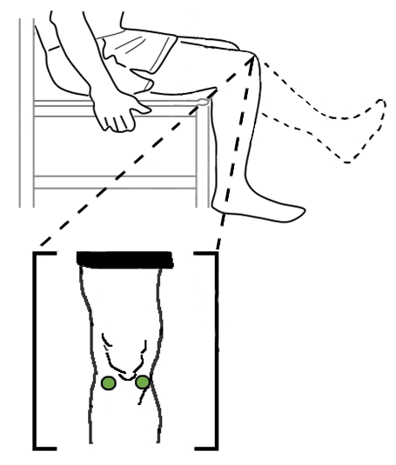
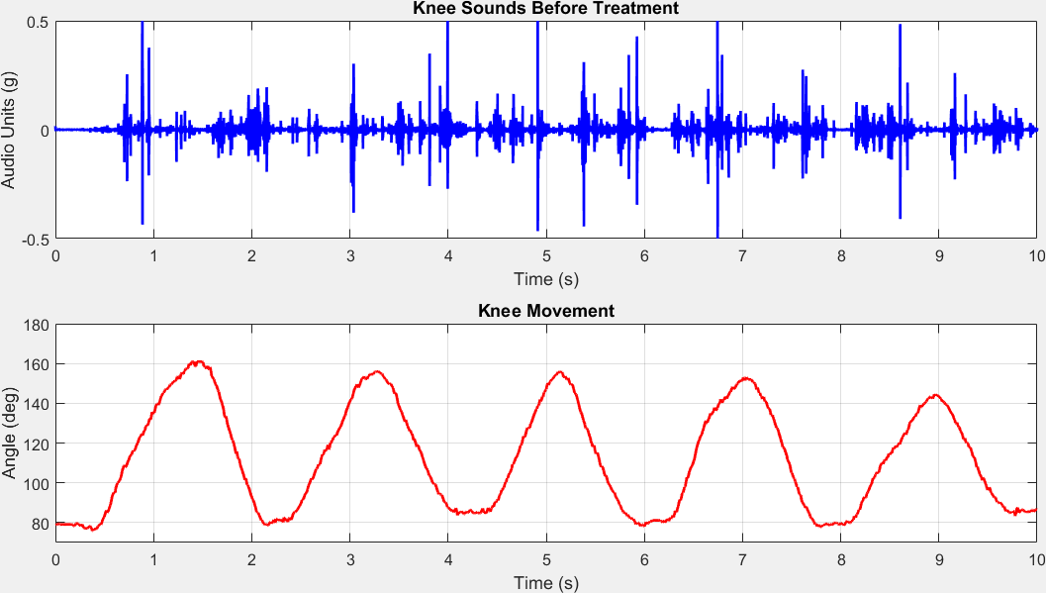



8. Design a study for testing your hypothesis
12 patients with JIA and 12 healthy controls recruited for AE assessment.
12 patients with JIA starting at the start of a new treatment and 3-6 months into that treatment will be recorded.
Microphone and IMU setup
10 Flexion/Extension & Squat Exercises
Pattern Analysis and Feature Comparison
Recruit Patients
10

Slide 10
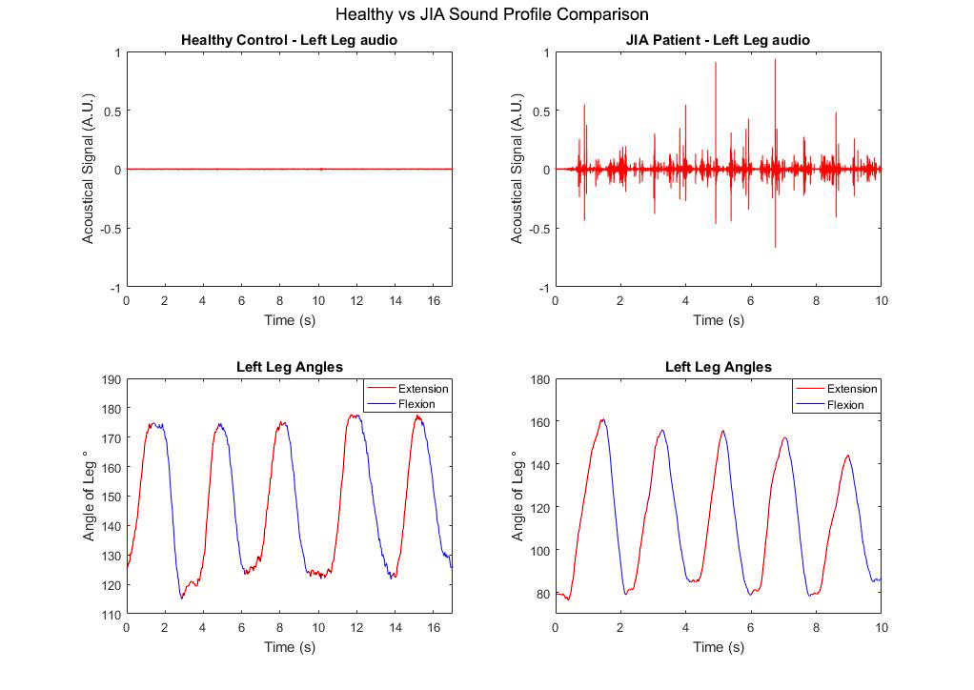
9. Get results! healthy Aes vs jia AEs vary in amplitude (Aim 2.1)
Fig 5. Representative knee AE signals from a healthy control (left) and a patient with JIA (right).
11

Slide 11

Healthy Knee
12

Slide 12

Arthritic Knee
13

Slide 13
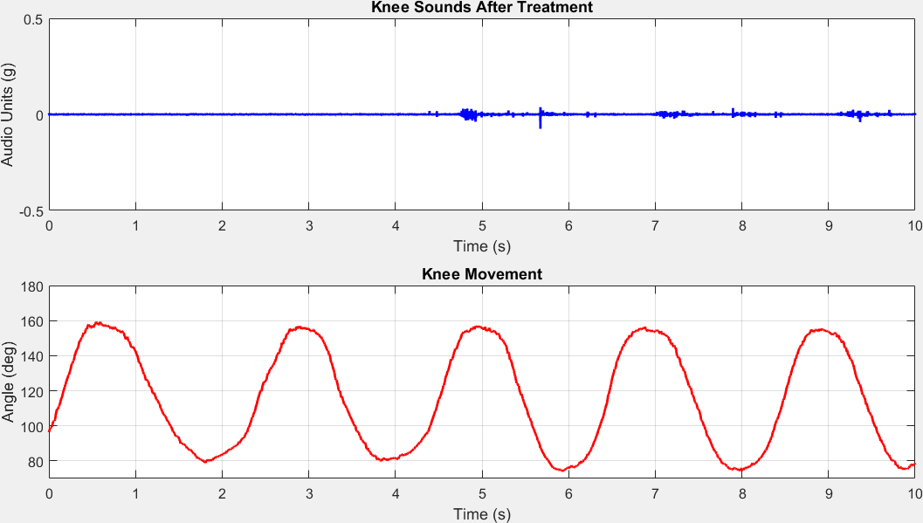
Knee Sounds –
Before and After Treatment
5 Months Later
14

Slide 14

10. Find a team and succeed together
Joint Sound Analysis: b-Value
  b-Value is a scaling of the magnitude distribution of acoustic emissions
  Indicates the relative number of local failures in materials under stress.
  Fig 6. b-Value Calculation.
Ref: Hyeon Ki Jeong, et al, “b-Value: A Potential Biomarker for Assessing Knee Joint Health using Acoustical Emission Sensing,” Sensors Letters. 2018.
15

Slide 15
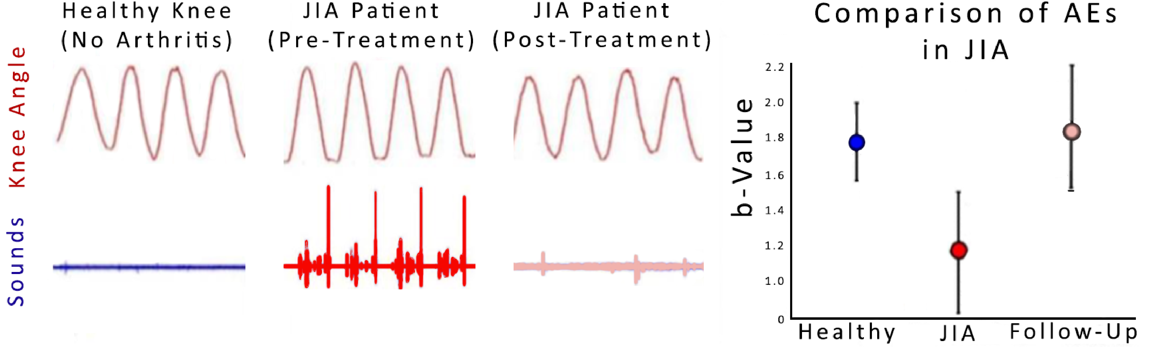
The b-value can quantify response to therapy in jia affected knees
Fig 7. Preliminary Longitudinal Comparison of AEs in JIA. (n=6)
16

Slide 16
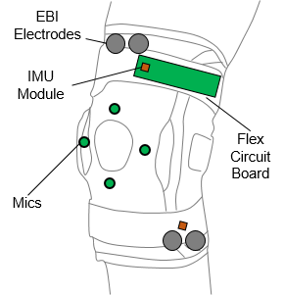

12. Dream big!
Ultimate Vision: Wearable Decision Aid for Joint
Health Management
Joint Health Score (for Patient / Caregiver)
Machine Learning Algorithms for Deriving Joint Health Score from Sensor Data
Smartphone with Arthritis Management App
Data Analytics Implemented on Cloud / Smartphone to Titrate Care Based on Joint Health
Smart Brace with Integrated Sensors and Electronics (Daily / Weekly Recordings taken at Home)
31
18

Slide 17


Tools I’ve found helpful
Found on dcwhittingslow.com
19

Slide 18
Questions?
Daniel Whittingslow
dcwhitt@emory.edu
20

